Slide 1
Structural Simulation Toolkit

Slide 2
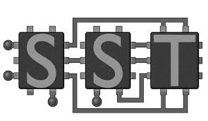
Structural Simulation Toolkit
Purpose:
SST is NOT a simulator. Rather, it provides the interface/framework to simulate whole systems through plugins termed “elements”.
Numerous applications exist to simulate specific computer architectures:
RTL sims → simulate hardware @ logic/gate/register level
OOO cache sims → instruction pipeline (test efficiency)
DRAM sims → test mem hierarchy designs & perf. under varying workloads
Network sims → simulate data transfer
Potential drawbacks of standalone sims:
Can’t interact with one another
Most likely designed to be single-threaded

Slide 3
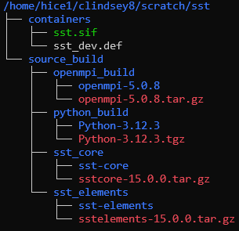
SST Directory Overview
Working SST dir in Scratch
Building an SST container image will be your first assignment.
Source compilation will be our focus today

Slide 4
Building Python 3 from source
Steps:
./configure --prefix=<path_to_Python3_home_dir> --enable-optimizations --with-ensurepip=install
--enable-optimizations → Tests are run that produce profiling data. Python3 is compiled according to this “profile guided optimization” approach, resulting in a faster python binary interpreter.
--with-ensurepip=install → Auto install pip with the new Python build
make –j8
make install
export PATH=~/python_build/Python-3.12.3/bin:$PATH

Slide 5
Building OpenMPI from source
Why:
Originally, I compiled SST on a cluster that did not have OpenMPI installed.
On Phoenix and ICE, loading the openmpi module works…
…However, your first assignment is to create a container definition file.
Since these are portable, there is the possibility that a system your def file gets transferred to does not have modules or OpenMPI installed.
Depending on the package manager (OS dependent), you may not have the option to install OpenMPI.
dnf install openmpi openmpi-devel
I ran into OpenMPI errors while building SST when installing OpenMPI via dnf.

Slide 6
Building OpenMPI from source
Steps for local installation:
./configure --prefix=<path_to_OpenMPI_home_dir>
make –j8 all
make install
export OMPI_DIR=<path_to_OpenMPI_home_dir>
export PATH=$OMPI_DIR/bin:$PATH
export LD_LIBRARY_PATH=$OMPI_DIR/lib:$LD_LIBRARY_PATH

Slide 7
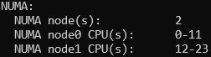
Building OpenMPI from source
Steps for container installation:
Install OpenMPI build dependencies --> SEE https://docs.open-mpi.org/en/v5.0.x/installing-open-mpi/required-support-libraries.html
Host of other packages that can be installed:
numactl-devel → improved memory placement on NUMA systems
hwloc-devel libevent-devel pmix-devel → SLURM-aware OpenMPI
libibverbs-devel → For Infiniband Networks
dnf -y install hwloc-devel libevent-devel numactl-devel pmix-devel libibverbs-devel

Slide 8
Building OpenMPI from source
Steps for container installation:
./configure --prefix=/opt/openmpi --with-slurm --with-pmix
--with-slurm → links SLURM’s dev headers and libs
--with-pmix →links OpenMPI to PMIX (e.g., pmix-devel that was installed)
make –j$(nproc) # uses all available procs during make
make install

Slide 9
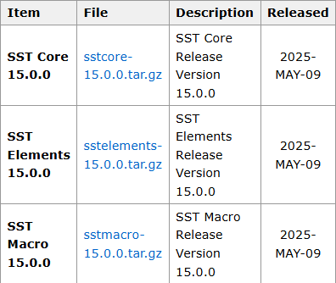
Building SST from source
Current Stable releases on SST’s site
sstelements-15.0.0.tar.gz

Slide 10
Building SST from source
Steps for SST-core installation:
./configure --prefix=<path_to_SSTcore_home_dir> CC=`which gcc` CXX=`which g++` MPICC=`which mpicc` MPICXX=`which mpicxx`
make –j8
make install
Steps for SST-elements installation:
./configure --prefix=< path_to_SSTelements_home_dir > --with-sst-core=< path_to_SSTcore_home_dir >
make –j8
make install

Slide 11
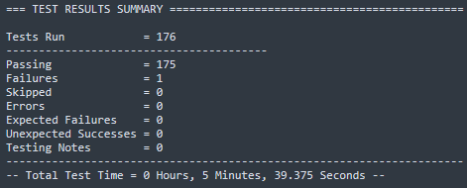
Building SST from source
Run the following command line execution:
sst-test-core
- FAILED : test_sstinfo_coretestelement (testsuite_default_sstinfo.testcase_sstinfo.test_sstinfo_coretestelement)
This is not necessary for SST to run correctly. This affects the `sst-info` command.

Slide 12
Running a Simulation

Slide 13
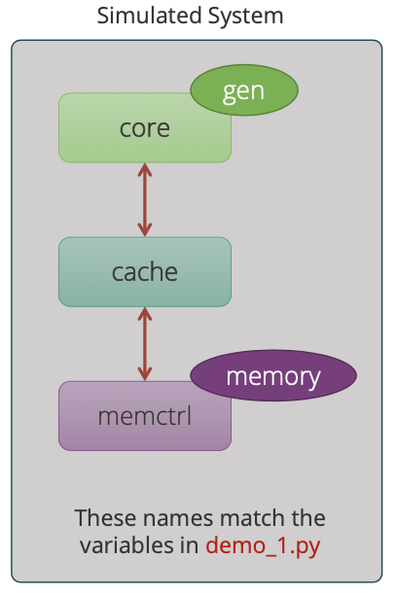
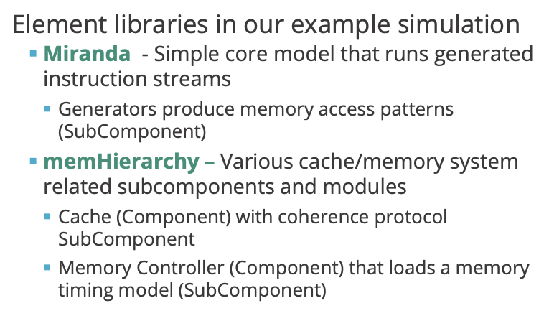

Slide 14
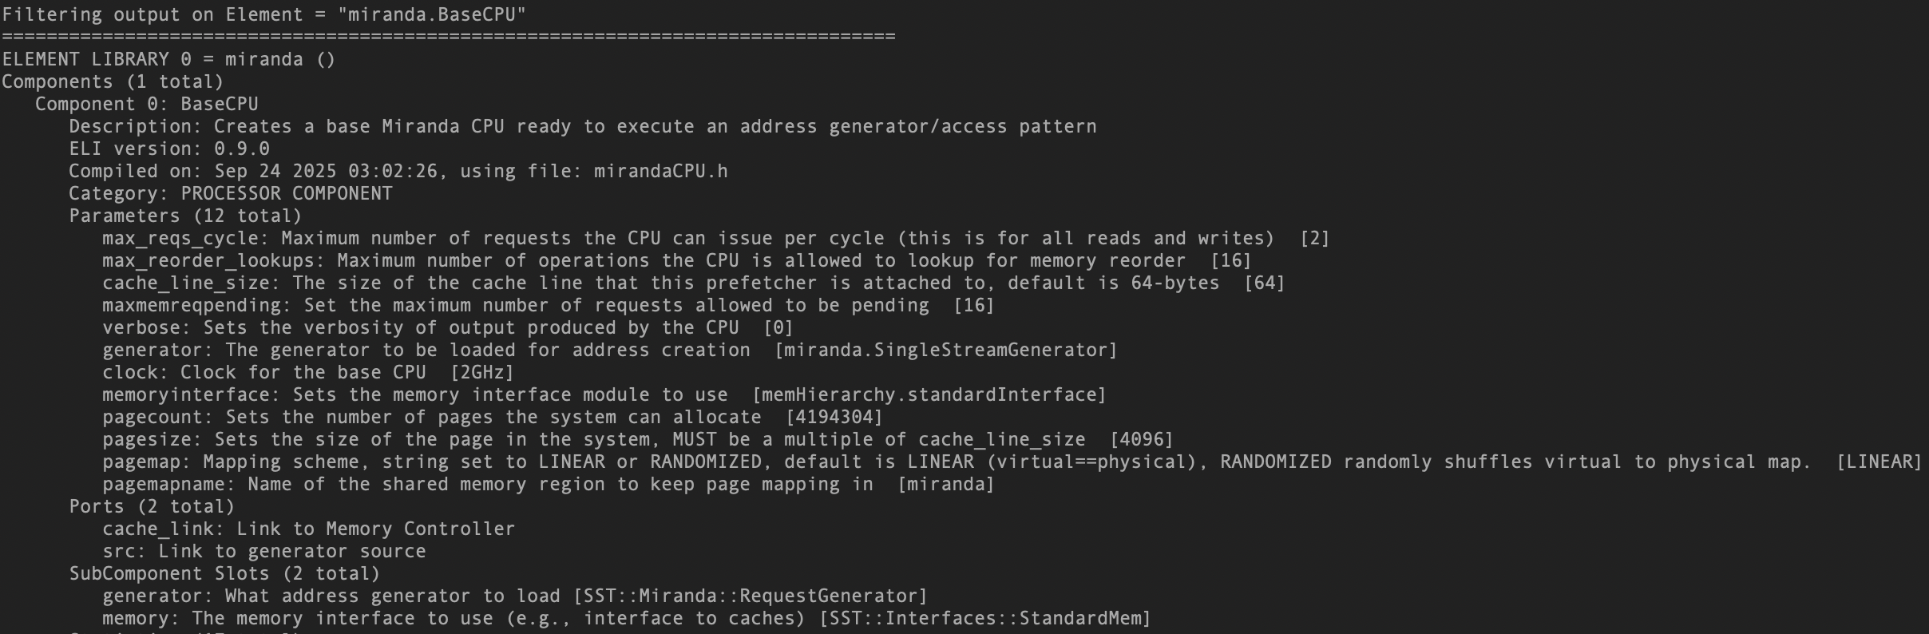
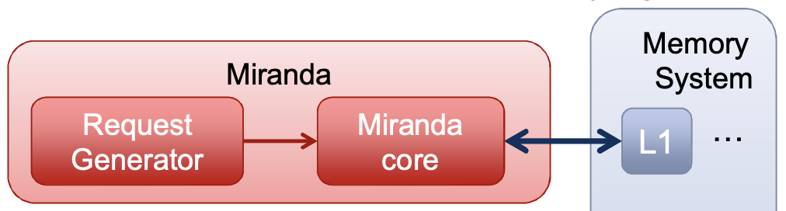
What is the Miranda CPU?

Slide 15
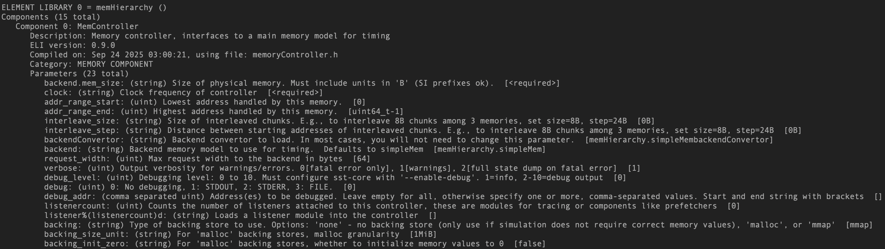
What is the Miranda CPU?
backend → timing model for memory.
backing → determines how memory is held and/or returned.

Slide 16
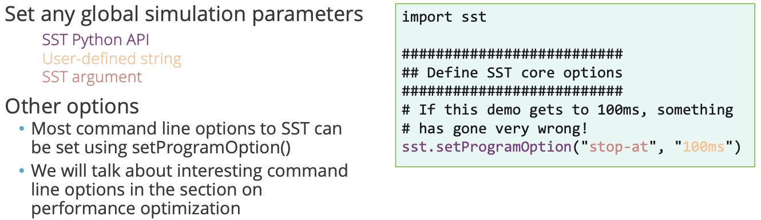
Simulation Input File

Slide 17
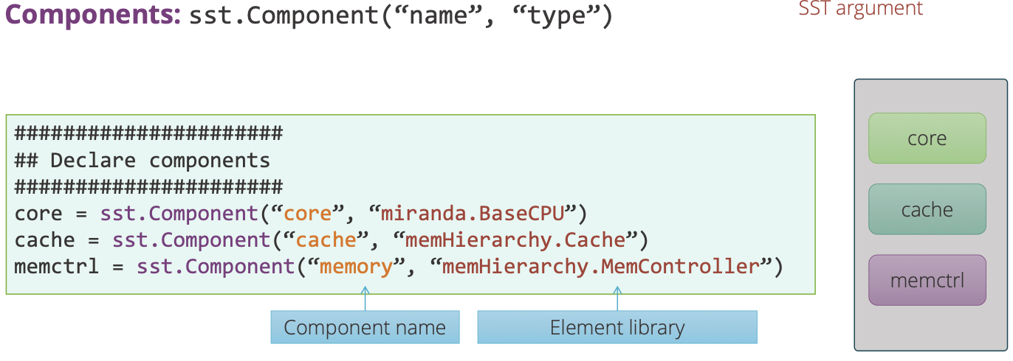
Simulation Input File

Slide 18
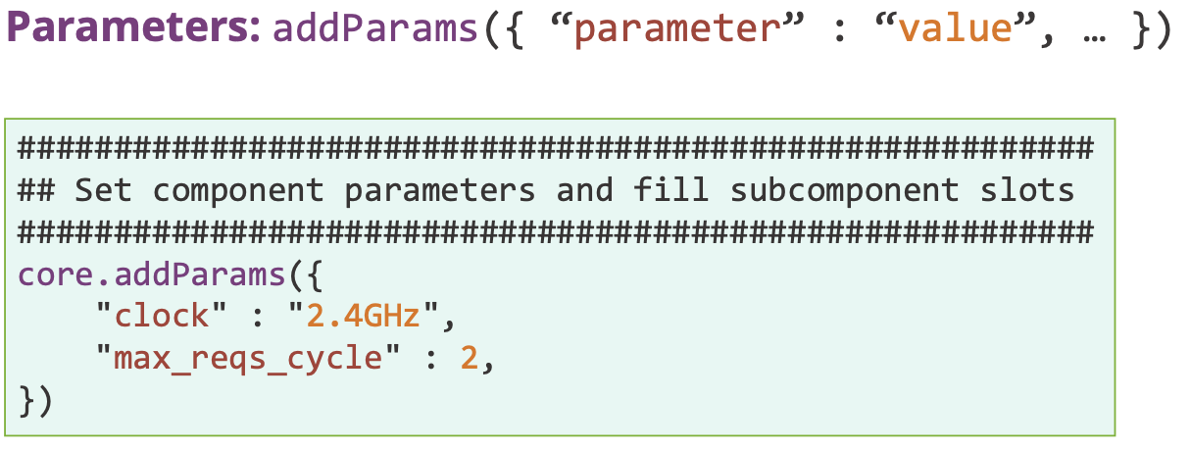
Simulation Input File
System still only has 3 main components

Slide 19
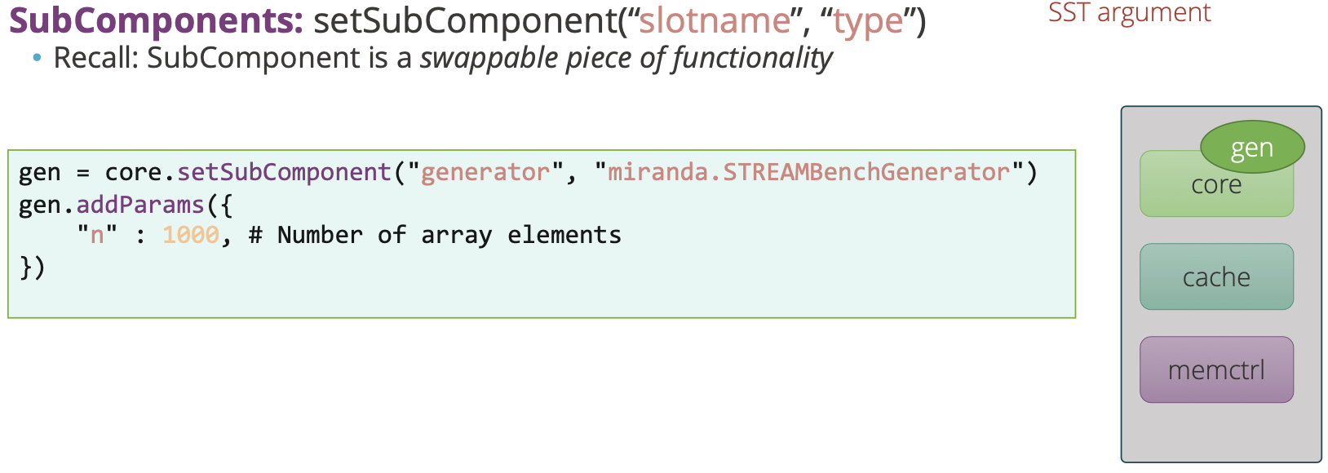
Simulation Input File
System now has:
3 main components
1 subcomponent

Slide 20
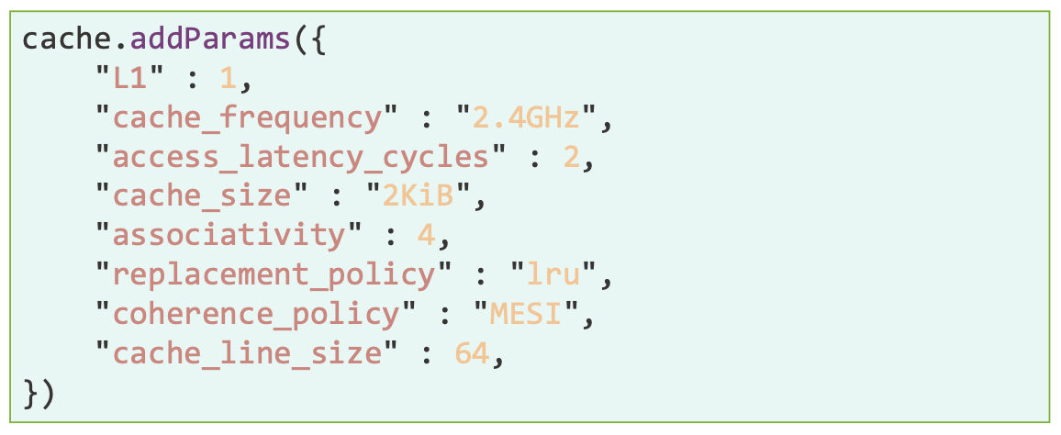
Simulation Input File
System now has:
3 main components
1 subcomponent

Slide 21
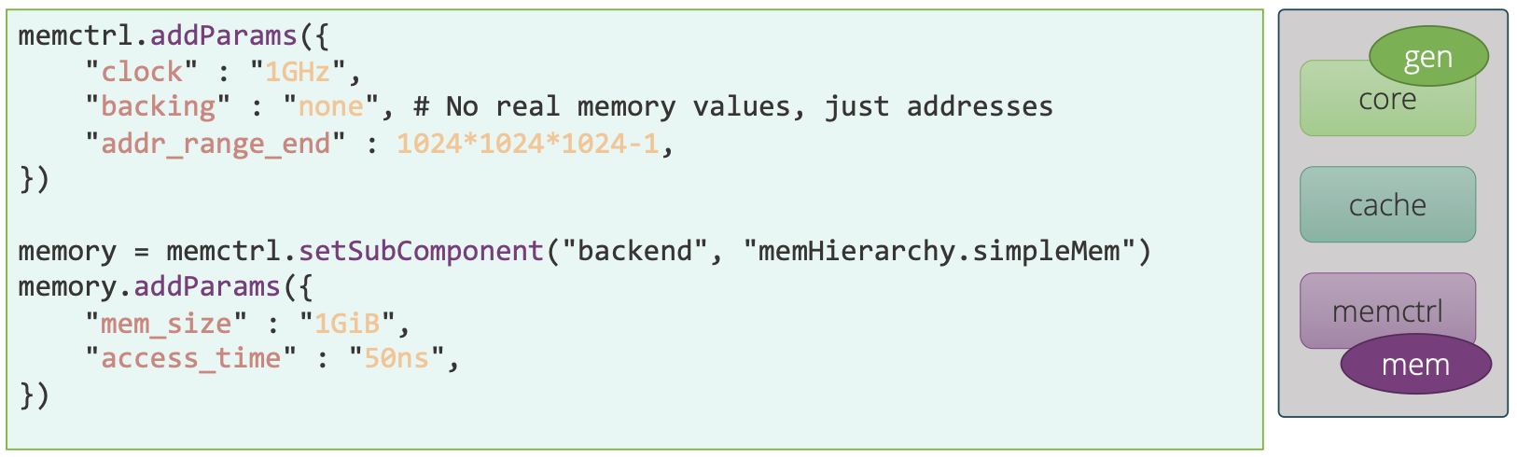
Simulation Input File
System now has:
3 main components
2 subcomponents

Slide 22
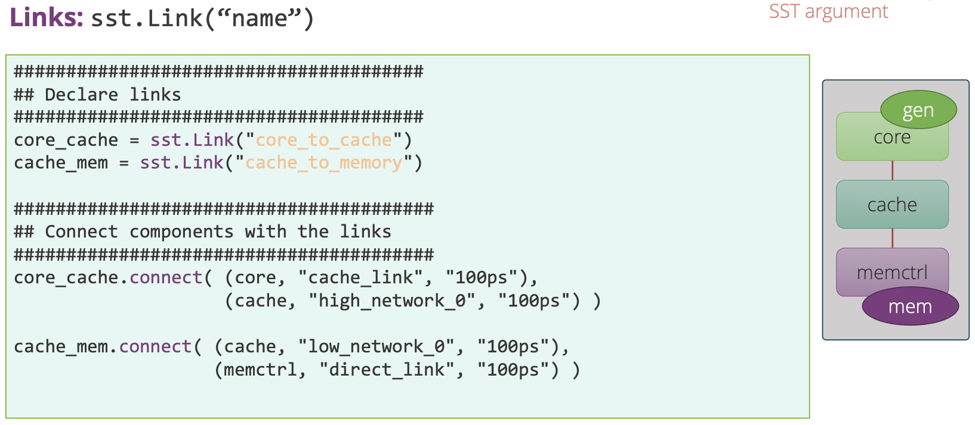
Simulation Input File
System now has:
3 main components
2 subcomponents
Links between components

Slide 23
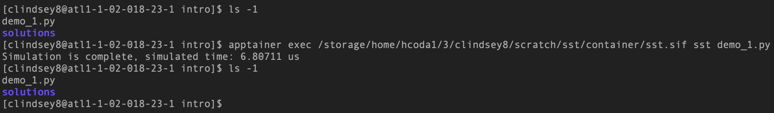
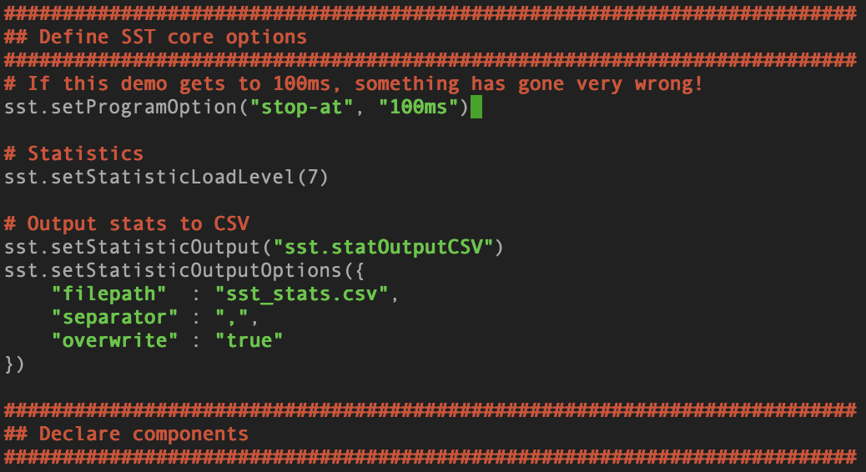
Running our Input File / Executing Simulation
Simply running SST on your simulation file does not produce any output other than ‘simulated time’
We need to add additional options to our input file

Slide 24
Assignment: Interpreting the outfile

Slide 25
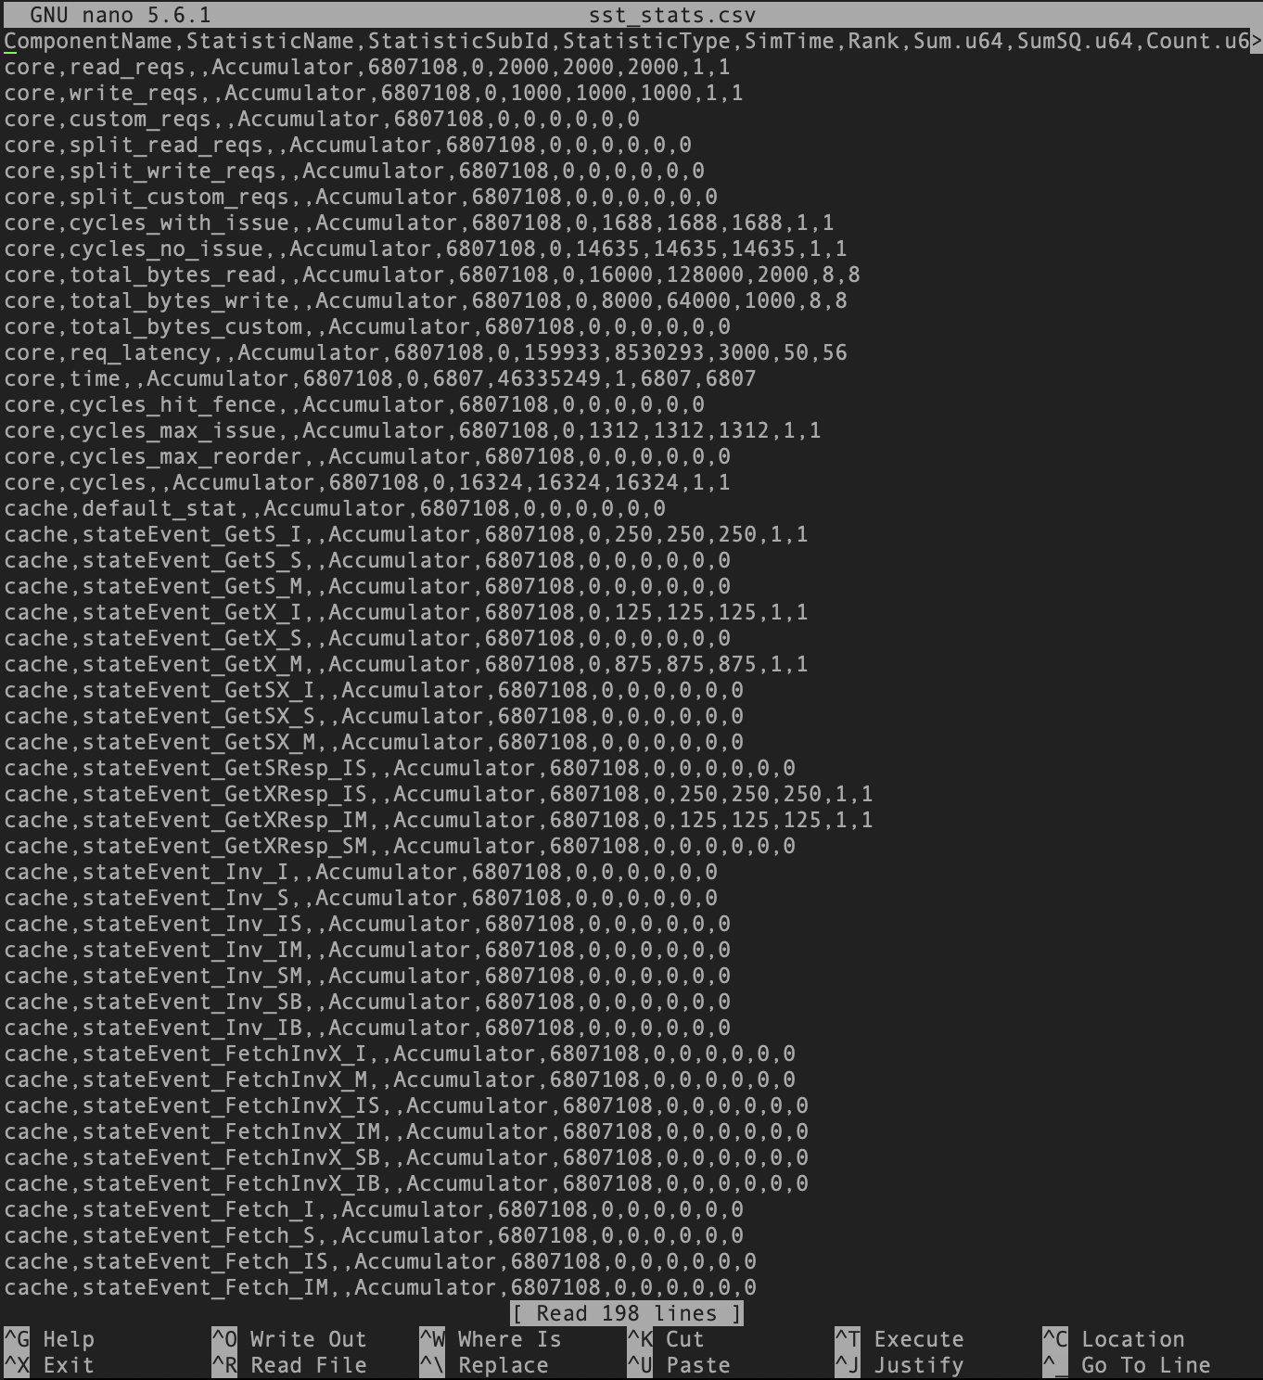
Sample questions:
Cache effectiveness
Cache hits
Cache misses
Miss rate
Throughput
Total CPU cycles
Requests per cycle
System bottleneck:
After going through the output file in this guided manner, hypothesize where you believe a bottleneck is occurring.

